Slide 1

JobShield: Fake Job Posting Detection Using Data Warehousing and Data Mining
CSA1606 -DATA WAREHOUSING AND DATA MINING
Course Faculty : S. Renuga,
SIMATS Engineering, SIMATS
A. Vivekanadha Reddy (192372353)
M. Mahesh (192224092)
N. Vignesh (192411087)

Slide 2

ABSTRACT
JobShield is a web-based fake job detection system.
It identifies genuine and fraudulent job postings using Machine Learning.
The system performs ETL (Extract, Transform, Load) on job datasets.
TF-IDF converts job descriptions into numerical features.
Four classification algorithms are trained and compared.
Random Forest is selected as the best-performing model.
The application provides real-time job prediction through a dashboard.
CAPSTONE PROJECT

Slide 3
INTRODUCTION
Online recruitment has increased rapidly worldwide.
Fake job postings have become a major cybersecurity issue.
Many applicants lose money through recruitment scams.
Manual verification of job advertisements is time-consuming.
Machine Learning enables automatic fraud detection.
JobShield helps users identify suspicious job postings.
The system improves recruitment security and user awareness.
CAPSTONE PROJECT

Slide 4
LITERATURE REVIEW
S.NO | DETAILS OF TH JOURNAL | ALGORITHM / METHODOLOGY USED | ADVANTAGES | DIS ADVANTAGES
1 | Shekhar et al. (2020) – Fake Job Posting Detection Using Machine Learning | ETL, TF-IDF, Random Forest | High classification accuracy and effective text analysis | Requires extensive data preprocessing and higher training time
 | Shekhar et al. (2020) – Fake Job Posting Detection Using Machine Learning | ETL, TF-IDF, Random Forest | High classification accuracy and effective text analysis | Requires extensive data preprocessing and higher training time
2 | Shekhar et al. (2020) – Fake Job Posting Detection Using Machine Learning | ETL, TF-IDF, Random Forest | High classification accuracy and effective text analysis | Requires extensive data preprocessing and higher training time
3 | Shekhar et al. (2020) – Fake Job Posting Detection Using Machine Learning | ETL, TF-IDF, Random Forest | High classification accuracy and effective text analysis | Requires extensive data preprocessing and higher training time
4 | Shekhar et al. (2020) – Fake Job Posting Detection Using Machine Learning | ETL, TF-IDF, Random Forest | High classification accuracy and effective text analysis | Requires extensive data preprocessing and higher training time
5 | Shekhar et al. (2020) – Fake Job Posting Detection Using Machine Learning | ETL, TF-IDF, Random Forest | High classification accuracy and effective text analysis | Requires extensive data preprocessing and higher training time
CAPSTONE PROJECT

Slide 5
PROBLEM STATEMENT
Online job scams are increasing every year.
Applicants cannot easily distinguish fake jobs.
Fraudulent recruiters demand registration or processing fees.
Manual verification requires significant time and effort.
Existing systems lack intelligent fraud detection.
There is a need for an automated detection system.
The proposed system solves this problem using Machine Learning.
CAPSTONE PROJECT

Slide 6
OBJECTIVES OF THE CAPSTONE PROJECT
Detect fake and genuine job postings automatically.
Perform ETL on large recruitment datasets.
Extract important textual features using TF-IDF.
Train multiple Machine Learning algorithms.
Compare model performance using evaluation metrics.
Deploy the best model in a Flask web application.
Provide accurate predictions through an interactive dashboard.
CAPSTONE PROJECT

Slide 7
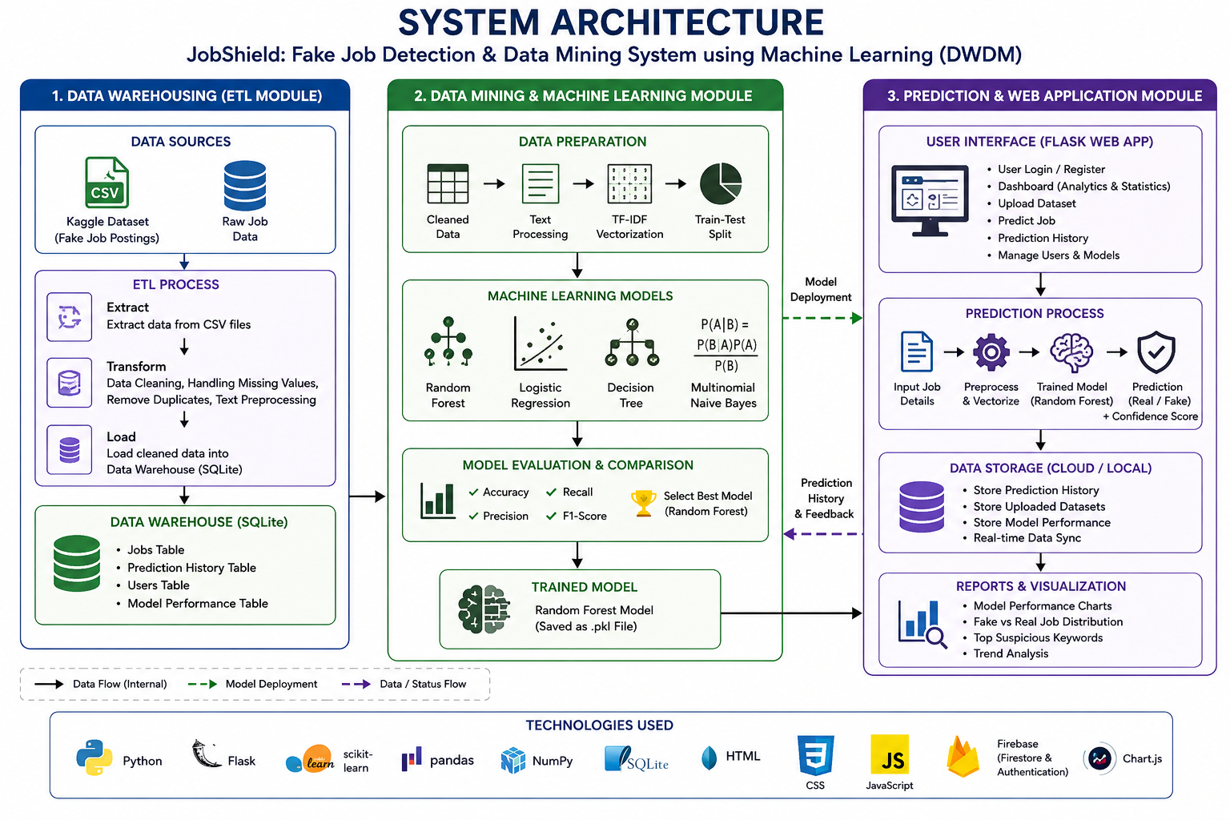
PROPOSED METHODOLOGY – ARCHITECTURE DIAGRAM
3/27/2025
CAPSTONE PROJECT

Slide 8
Module 1 : Data Collection & ETL Process
Collect the Fake Job Postings dataset from Kaggle.
Extract job records from the CSV dataset.
Validate the dataset structure and required attributes.
Remove duplicate job postings.
Handle missing or incomplete values.
Clean and preprocess textual data (description, requirements, title).
Transform the cleaned data into a structured format.
Load the processed dataset into the SQLite Data Warehouse.
CAPSTONE PROJECT

Slide 9
Module 2 : Data Mining & Model Training
Retrieve processed data from the Data Warehouse.
Combine relevant text fields for analysis.
Apply TF-IDF feature extraction.
Split the dataset into training and testing sets.
Train the Random Forest Classifier.
Train Logistic Regression, Decision Tree, and Naive Bayes models.
Evaluate models using Accuracy, Precision, Recall, and F1-Score.
Select the best-performing model (Random Forest – 97.56%).
CAPSTONE PROJECT

Slide 10
Module 3 : Prediction & Web Application
Save the trained model and TF-IDF vectorizer.
Develop the Flask-based web application.
Implement secure user and admin authentication.
Allow administrators to upload new datasets.
Accept job details entered by the user.
Predict whether the job is Genuine or Fake.
Display prediction confidence and classification result.
Store prediction history and generate dashboard reports with analytics.
CAPSTONE PROJECT

Slide 11
APPLICATIONS OF THE RESEARCH
Online recruitment platforms.
Human Resource departments.
Employment verification systems.
Career guidance portals.
Government employment agencies.
Job search websites.
Fraud detection in recruitment systems.
CAPSTONE PROJECT

Slide 12

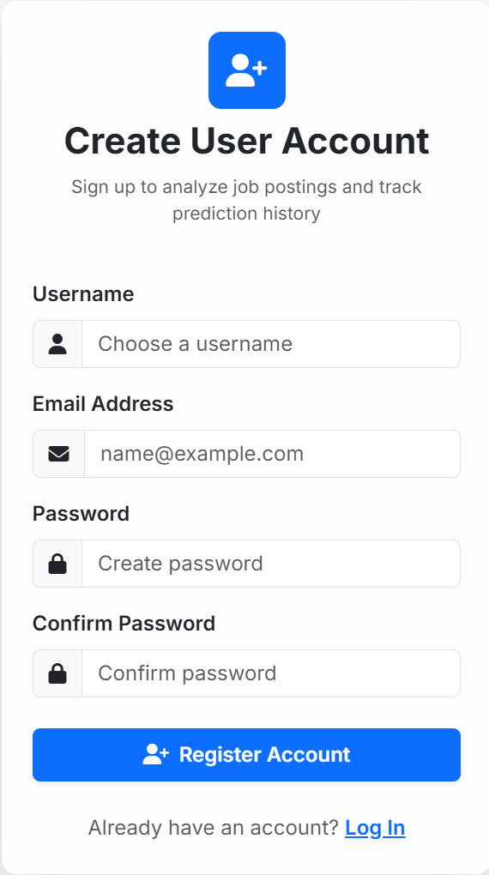
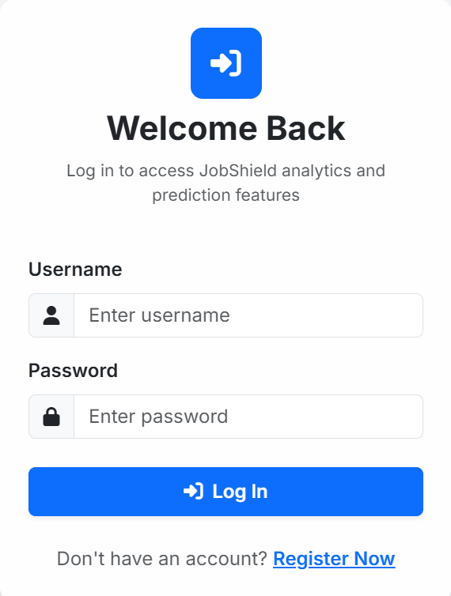
PROJECT DEMO
CAPSTONE PROJECT

Slide 13
DESCRIPTION ABOUT THE DATASETS USED
Dataset obtained from Kaggle.
Contains genuine and fraudulent job postings.
Includes job title, description, company, and requirements.
Target column is "Fraudulent".
Total records: 17,880.
Dataset cleaned using ETL techniques.
Used for training and testing Machine Learning models.
CAPSTONE PROJECT

Slide 14
RESULTS AND DISCUSSION
Random Forest achieved highest accuracy.
Accuracy obtained: 97.56%.
Decision Tree showed highest F1 Score.
Logistic Regression produced good precision.
Naive Bayes completed training fastest.
Dashboard displayed comparison charts.
Model performed well on real-world job postings.
CAPSTONE PROJECT

Slide 15
COMPARISON AND ANALYSIS
Random Forest Accuracy – 97.56%
Decision Tree Accuracy – 96.87%
Logistic Regression Accuracy – 96.71%
Naive Bayes Accuracy – 96.01%
Random Forest selected as production model.
Evaluation based on Accuracy, Precision, Recall, and F1 Score.
Random Forest provided the best overall performance.
CAPSTONE PROJECT

Slide 16
CONCLUSION
Successfully developed JobShield web application.
ETL pipeline processed recruitment data efficiently.
Multiple Machine Learning algorithms were compared.
Random Forest achieved the highest accuracy.
Dashboard provides real-time analytics.
System predicts fake jobs effectively.
Project meets the objectives successfully.
CAPSTONE PROJECT

Slide 17
FUTURE ENHANCEMENTS
Integrate Deep Learning models (BERT/LSTM).
Add company reputation analysis.
Detect fake recruiter profiles.
Develop browser extension support.
Implement multilingual job detection.
Integrate real-time job portal APIs.
Improve prediction accuracy using larger datasets.
CAPSTONE PROJECT

Slide 18
THANK YOU
CAPSTONE PROJECT

